Slide 1

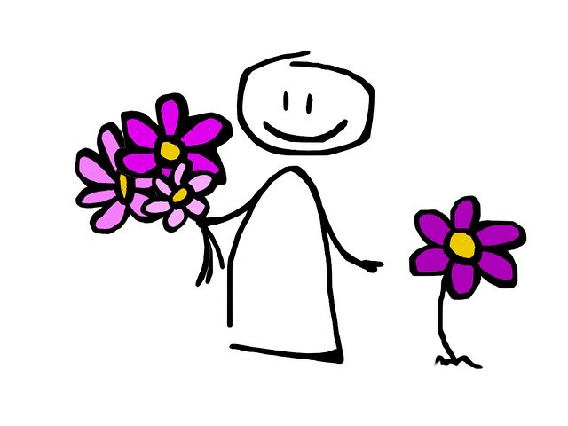
Welcome to the Guidance Corner!
Ms. S. Williams, Guidance Counselor
Ms. K. Williams, Social Worker
Ms. A. Campbell, Health and Wellness Specialist

Slide 2
Welcome to the Guidance Corner!
Contact Information:
Ms. S. Williams, Guidance Counselor
Email: williamss5@leonschools.net
Ms. K. Williams, Social Worker
Email: williamsk5@leonschools.net
Ms. A. Campbell, Health and Wellness Specialist
For an on-line session go to : https//:discvillage.com

Slide 3
Welcome to Ms. Williams Guidance Class
Week #3: April 13 – April 17
What is SEL?
Social and emotional learning (SEL) is the process through which children and adults understand and manage emotions, set and achieve positive goals, feel and show empathy for others, establish and maintain positive relationships, and make responsible decisions.
Provided by https://Casel .org
Parents please take few minutes and watch this short video:
English--https://www.youtube.com/watch?v=y2d0da6BZWA
Spanish--https://www.youtube.com/watch?v=xz_aCbDI9uk&feature=emb_rel_end
Ms. Williams, Guidance Counselor
Email address:
WILLiamss5@leonschools.net
Hi Riley Bears!
You know what I miss most about school?
Your smiling faces!
What do you miss?
Learning Goals of the Week:
1. Students will develop an emotional understanding, including recognizing feelings and identifying their causes and consequences.
2. Students will develop and recognize empathy.
Need a chat session?
Email me so I can invite you to a virtual meeting during my office hours:
Monday-Friday
10:00 a.m. – 12:00 p.m.

Slide 4
Empathy: Recognizing Feelings
K-2
Tim forgot his lunch today. How does Tim feel?
How can you help Tim feel better?
How would you feel if you left your lunch at home?
Can you draw me a picture of your face and send it to me by email?
3-5
Calvin said to himself when he got his grade:
“Oh no, I got such a bad grade! I didn’t study as hard as I should have. I’m going to have to study a lot harder for the next test.”
Our thoughts are like thought bubbles that only we can see
Can you draw me a picture that shows how Calvin is feeling and send it to me by mail?
My email: williamss5@leonschools.net
Students keep in mind that people often feel differently about the same situation.

Slide 5
Welcome to Ms. Williams Guidance Class
Week #4: April 27 – April May 1st
Part 1 :How to Practice being Safe and Staying Safe!
Ms. Williams, Guidance Counselor
Email address:
WILLiamss5@leonschools.net
Learning Goals of the Week:
Students will learn and practice being safe strategies.
If you see something say something!
Hi Riley Bears!
You know what I miss most about school?
Checking out books in the school library!
What do you miss?
Focus on TIPS!
T- The GOAL
I- IS TO
P-PRACTICE BEING
S-SAFE!
Need a chat session?
Email me so I can invite you to a virtual meeting during my office hours:
Monday-Friday
10:00 a.m. – 12:00 p.m.

Slide 6

Do you know?
You Can Stop Human trafficking:
Know the signs
Report the Crime
What is Human Trafficking?
Human Trafficking, under both federal and Florida law, is defined as the transporting, soliciting, recruiting, harboring, providing or obtaining of another person for transport; for the purposes of forced labor, domestic servitude or sexual exploitation using force, fraud and/or coercion. Human trafficking is modern slavery.
Parent please watch these short videos with your child:
Stranger Danger, Help, Help! Video by Pasco County Schools
https://www.youtube.com/watch?v=A55bwVVDQTU
Stranger Awareness for Kids-Billy to the Bus
https://www.youtube.com/watch?v=fEtJtFEVDbI
Parents how to report :
BeFree Textline Text "BeFree" (233733)
Florida Abuse Hotline - 1-806-96-ABUSE (1-800-962-2873)
Local Law Enforcement - 911

Slide 7
Welcome to Ms. Williams Guidance Class
Week #6: May4th – May 8th
Part 2 :How to Practice being Safe and Staying Safe!
Just Say No To Drugs!
Ms. Williams, Guidance Counselor
Email address:
WILLiamss5@leonschools.net
Focus on TIPS!
T- The GOAL
I- IS TO
P-PRACTICE BEING
S-SAFE!
Hi Riley Bears!
What’s the name of the last book you read?
I read Dragon-breath Book 1
by Ursula Vernon!
What book are you reading?
Learning Goals of the Week:
1. Students will develop a better understanding of recognizing saying no to stay healthy.
2. Students will recognize that tobacco use is harmful to your body.
3. Students will focus on a healthy body.
Parents please click the link below. Wise Owl explains what it means to be cool: Is That Good for Me?
https://dcmp.org/media/6682-wise-owl-s-drug-safety-kit-part-one-is-that-good-for-me
Need a chat session?
Email me so I can invite you to a virtual meeting during my office hours:
Monday-Friday
10:00 a.m. – 12:00 p.m.

